Slide 1
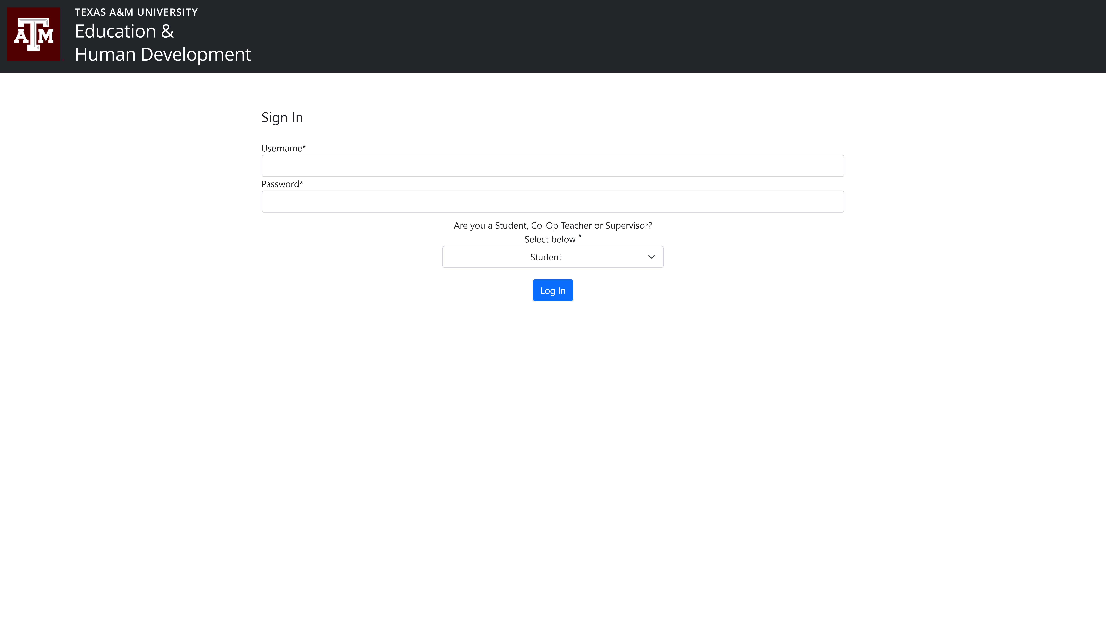
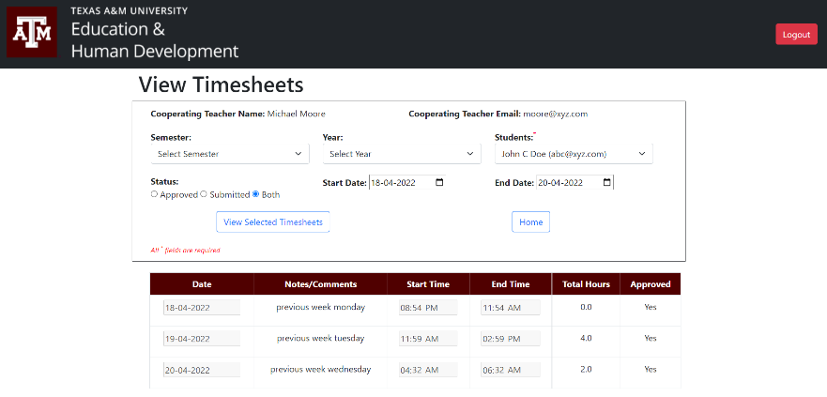
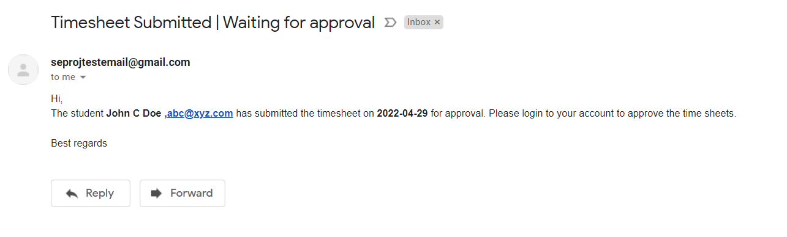
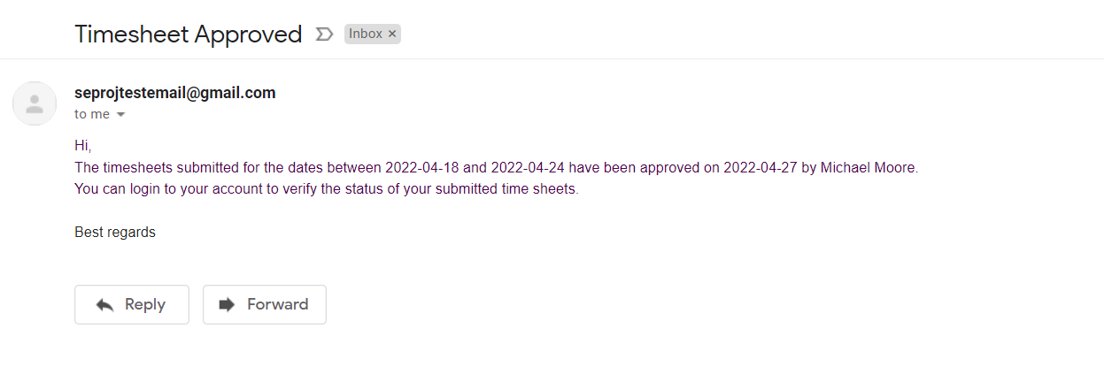
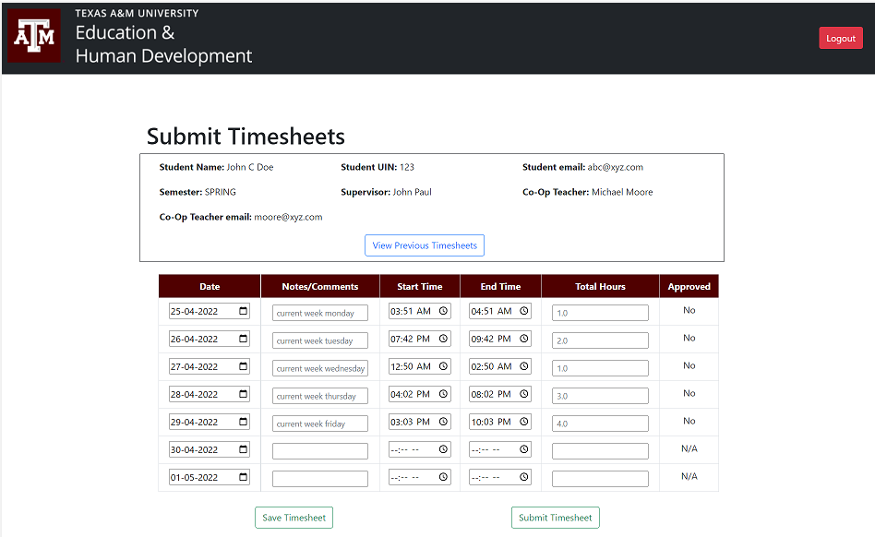
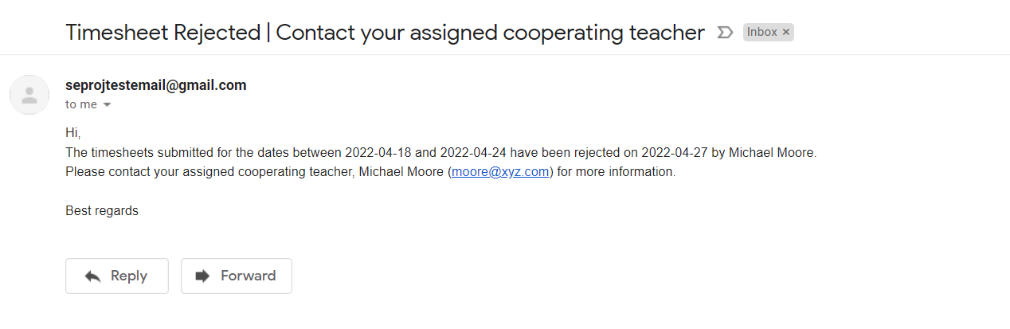
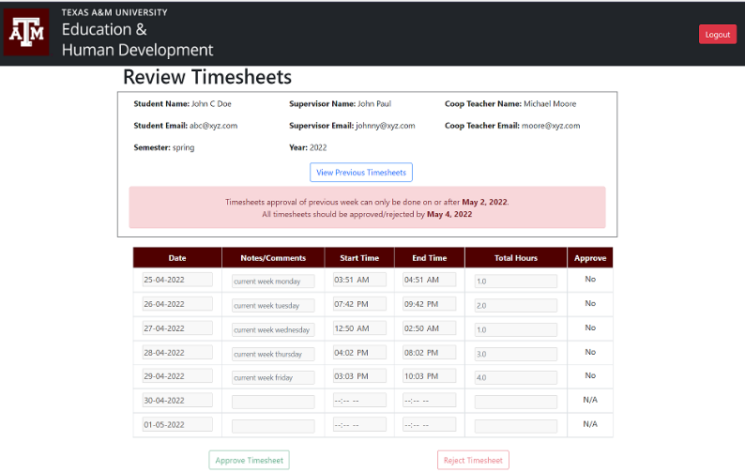
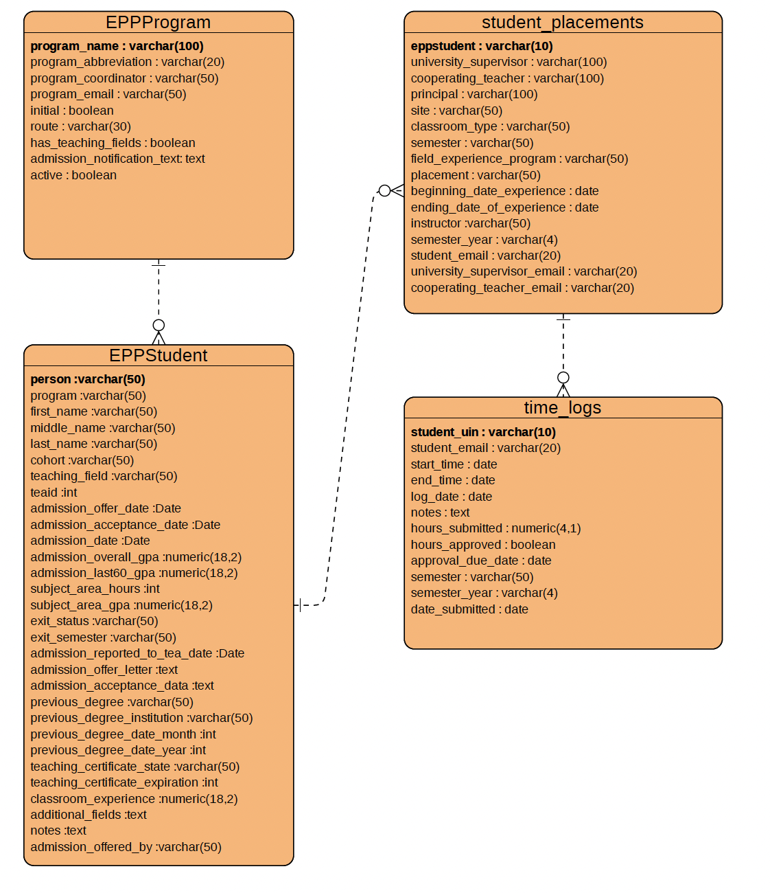
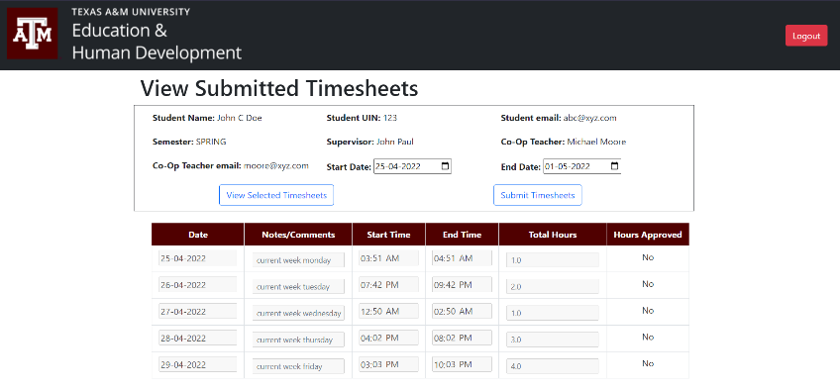
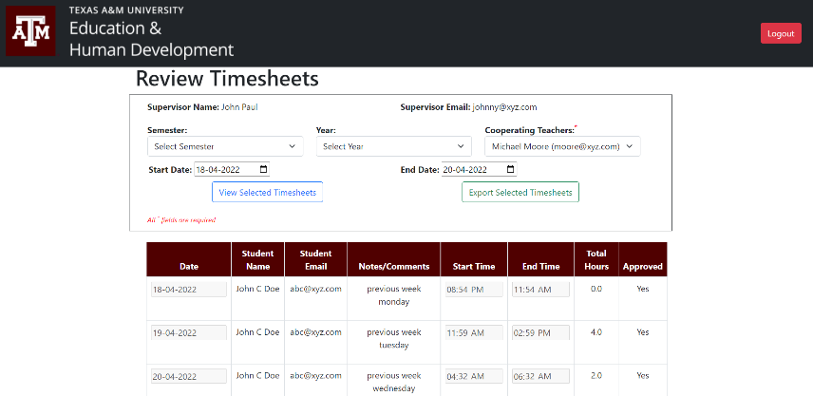
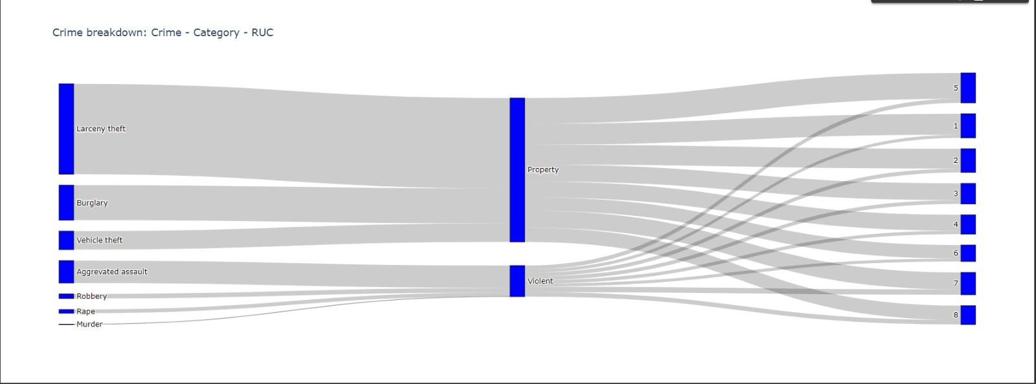
CEHD Teacher Certification Manager
Manisha Dixit, Piyush Nayak, Rajesh Satpathy, Sanjay Nayak, Sruti Patnaik
Texas A&M University, College Station, TX
INTRODUCTION
FEATURES
View Timesheet - Coop Teacher
Email Functionality
The main objective of the project is to create an application to record, maintain and approve the time logs of the students. This is a new application which is being designed to address the requirement of the College of Education and Human Development (CEHD). The students would be filling the time logs for each working day in the application, which would be notified via mail to the cooperating teacher for approval of the student time-logs.
User Authentication
The coop teacher can view the current week timesheet that the student has submitted for the approval. The co-op teacher has flexibility to select start-date and end date , semester, semester year and student from the drop-down provided.
Whenever the student submits the timesheet, the co-op teacher is notified via email to approve or reject the timesheet. And whenever the co-op teacher rejects or approves the timesheet, the student is notified via email to make changes and resubmit the updated timesheet if needed.
The user can login as a student, co-op teacher or supervisor with their credentials.
TOOLS USED
GitHub
Heroku
AWS RDS
Django REST Framework
SMTP
CodeClimate
Behave (Cucumber)
Submit Timesheet - Student
Approve Timesheet - Coop Teacher
ER- Diagram
The user can login as a student, co-op teacher or supervisor with their credentials.
Tables already existing in system on which we have dependency :
EPPProgram
EPPStudent
Tables created for this application:
Student_Placements
Time_Logs
The coop teacher can view and approve the current week timesheet that the student has submitted for the approval. The coop teacher has flexibility to select start-date and end date , semester, semester year and student from the drop-down provided.
CONCLUSIONS
The application would help in digitalizing the manual timesheet logging and approval process of the students.
All the necessary features of submitting , viewing, updating, rejecting, the timesheets has been implemented in this release of the application.
View Submitted Timesheet - Student
The student can view the submitted timesheets and check approval status of the timesheets. The student can check previous submitted timesheets too.
View Timesheets – Supervisor
The supervisor can monitor the progress of the students under the coop teacher throughout the semester. The supervisor can view time logs of all the timesheets submitted by students under all co-op teachers.
Important Links :
Pivotal tracker :
https://www.pivotaltracker.com/n/projects/2555005
GitHub Repo : https://github.com/sanjaynayak1628/CEHD_Aggie_Educator_Portal/
Heroku deployment :
http://arcane-temple-55328.herokuapp.com/
Code Coverage : https://codeclimate.com/github/sanjaynayak1628/CEHD_Aggie_Educator_Portal

